Slide 1
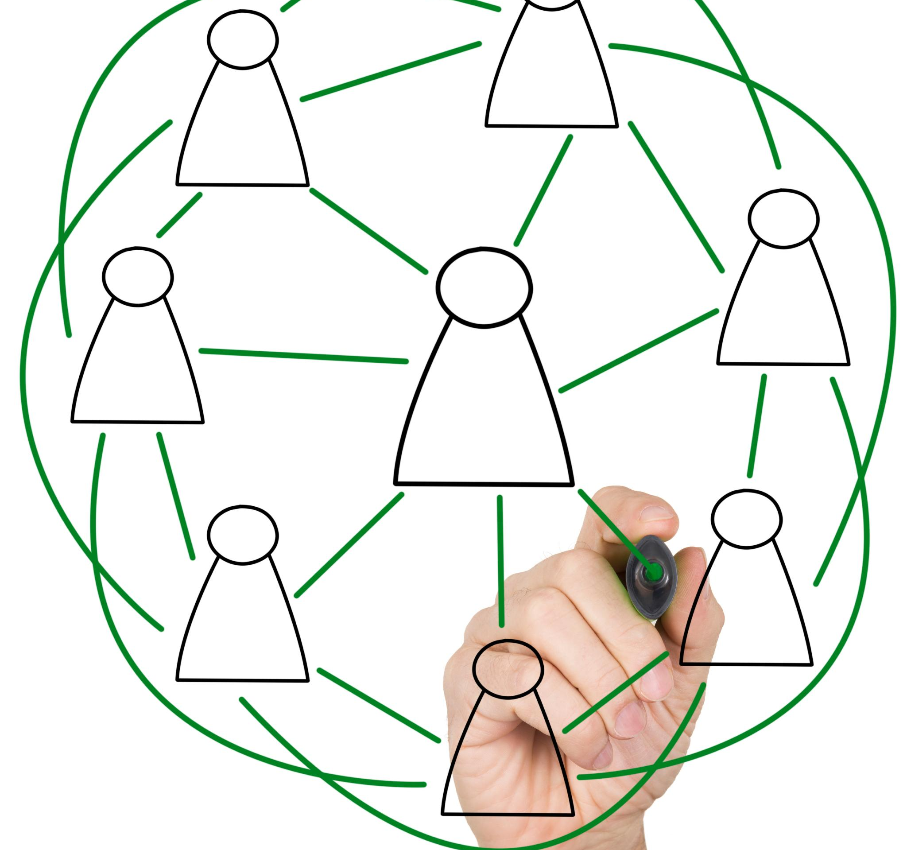
Introduction
Notes:
Bigsby is a user-centric learning application that takes inspiration from Obsidian, the note-taking app that connects different subjects together. Our goal was to build an autonomous testing and learning system that could evaluate, test, and build upon the user’s knowledge of subjects in order to help them learn.

Slide 2
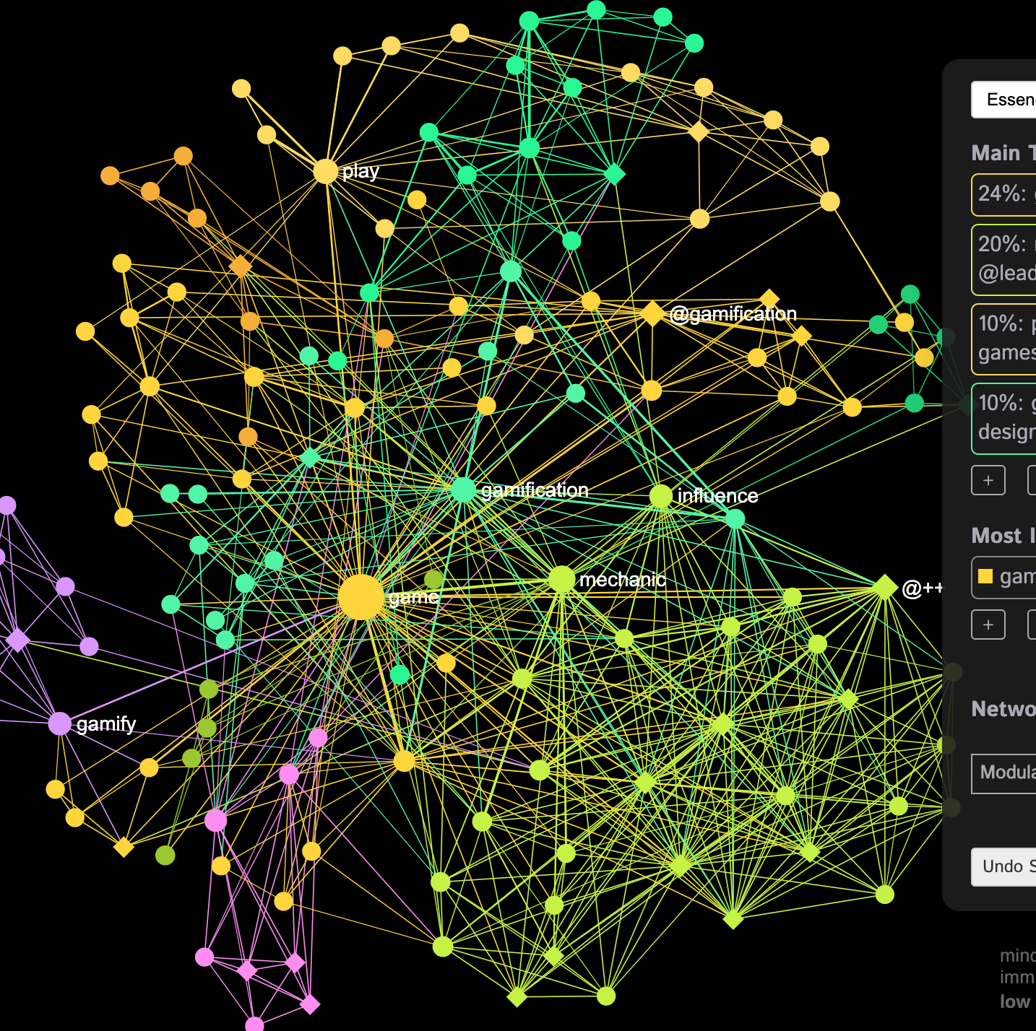
Autonomous Testing and Learning System
Our goal was to build an autonomous testing and learning system that would tailor content to users needs.
A driving idea for this project was taken from Obsidian, a note taking app. The ability to structure knowledge in a network is a key component of our application.
Our application leverages multiple different technologies and services, including NextJS, MongoDB, Auth0, and OpenAI.
Notes:
Bigsby leverages OpenAI services to tailor content specifically to user’s needs. The application uses machine learning and artificial intelligence to create a personalized learning experience for each user.

Slide 3
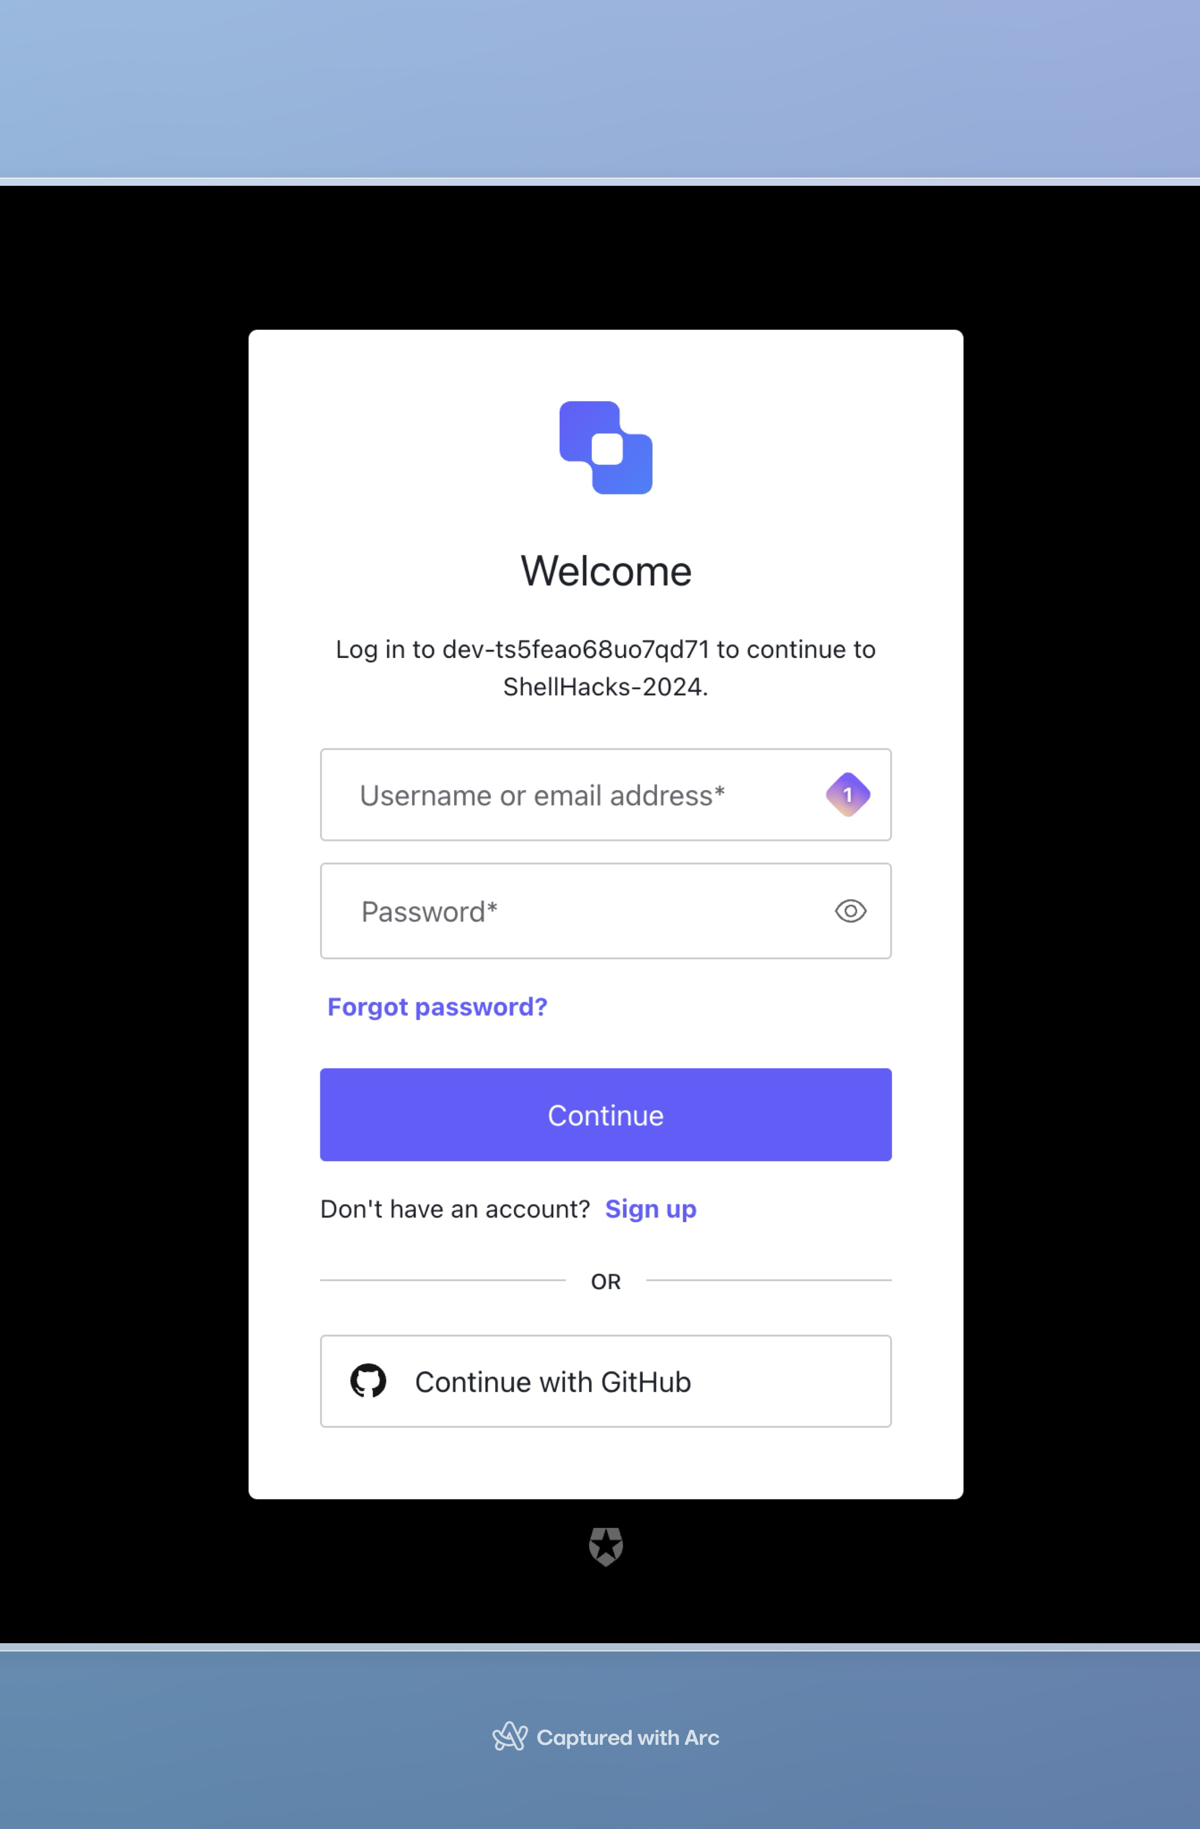
Security First
Our application utilizes AUTH0’s authentication and authorization services in our to secure our application, as well as our API endpoints.
By using their services, it ensures a seamless user onboarding flow by providing OAUTH 2.0 using their favorite services.
Notes:
Entering a topic into Bigsby generates a learning path. This path includes prerequisite topics and potential topics that the user may be interested in. The learning path is created in real-time and gets updated every time an action is taken within the application.

Slide 4
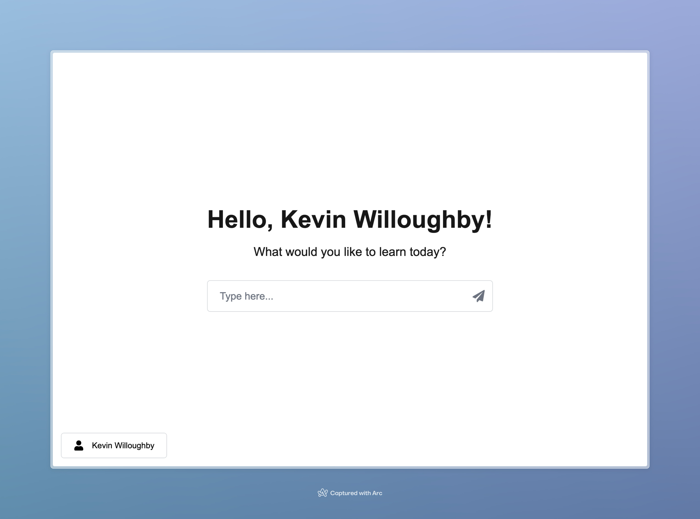
Getting Started
We built our app to be intuitive and easy to use for everyone.
Hidden behind the scenes are complex knowledge networks constantly built on by custom OpenAI function calls.
Knowledge levels are assessed and adjusted in real time to promote continuous learning.
Notes:
Bigsby's backend functionality uses OpenAI chat completions alongside custom-designed functions in prompts in order to achieve the self-directing learning path generation. The application generates topic nodes in real-time and updates them based on user actions. Users can view their knowledge tree in real-time and deep dive into specific topics.

Slide 5
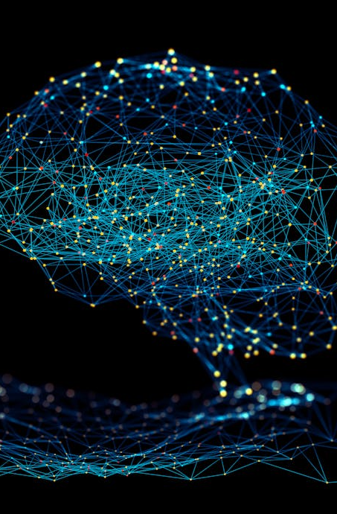
How Does It Work?
Our application can be envisioned into three services: application, backend, and OpenAI interface.
With serverless compute, NextJS hosted by Vercel allows us to complete backend API calls that interact with a custom built OpenAI interface.
These two-services work hand in hand two tune, modify, and provide the knowledge network to the user.
Notes:
Bigsby manages and updates topic nodes in real-time, ensuring that the application's learning path is always up-to-date. Users can easily change sessions and topics, allowing them to explore different areas of interest.

Slide 6
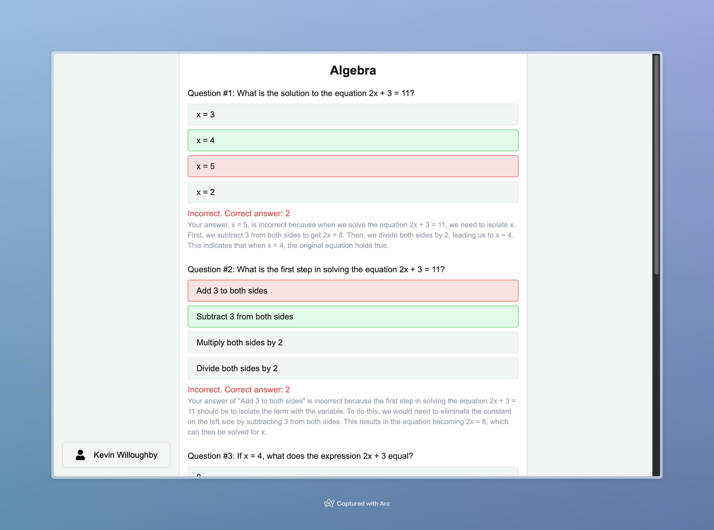
Continuous Improvement
The model adapts to how well the user answers questions.
When the user is wrong, it provides context and an explanation as to why they got it wrong.
Behind the scenes, the models are tweaked to provide relevant, engaging questions.

Slide 7
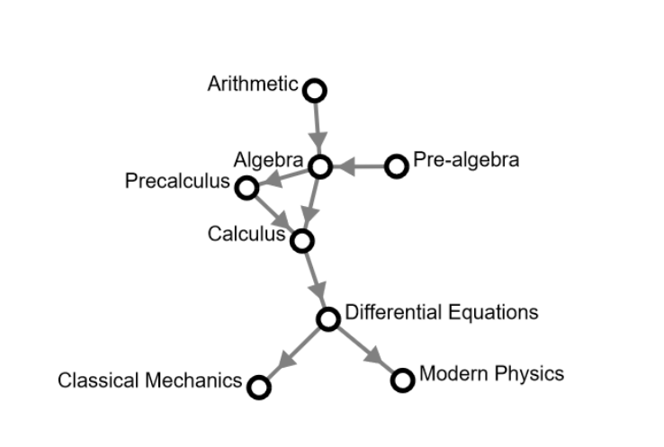
Ambitious Goals
Unfortunately, we were unable to implement our entire vision due to time constraints.
We plan on allowing users to persist their learning across sessions as well as deep dive into specific topics they feel they need help in.
Presenting the user their knowledge network was a feature we would have loved to deliver.
Notes:
While Bigsby's powerful prototype showcases our solution, we had ambitious goals and features that were not implemented due to time constraints. These features include the ability for users to switch sessions, deep dive into specific topics, and view their knowledge tree in real-time.

Slide 8

Powerful Prototype
Despite many challenges, we have been able to deliver a powerful prototype that showcases our solution.
Some technical challenges we ran into involved developing an interface with OpenAI’s services, as well as implementing Redux as a state-management system within NextJS.
We have learned so much and hope to build, iterate over, and improve Bigsby in the time to come.
Notes:
Despite the ambitious goals and features that were not implemented due to time constraints, the Bigsby prototype showcases our solution. The fully functional and effective prototype demonstrates how our autonomous testing and learning system works.

Slide 9

Conclusion
Notes:
In conclusion, Bigsby is a user-centric learning application that leverages OpenAI services to tailor content specifically to user’s needs. The application uses machine learning and artificial intelligence to create a personalized learning experience for each user. Our powerful prototype showcases how our autonomous testing and learning system works. Thank you for your attention.

